Slide 1


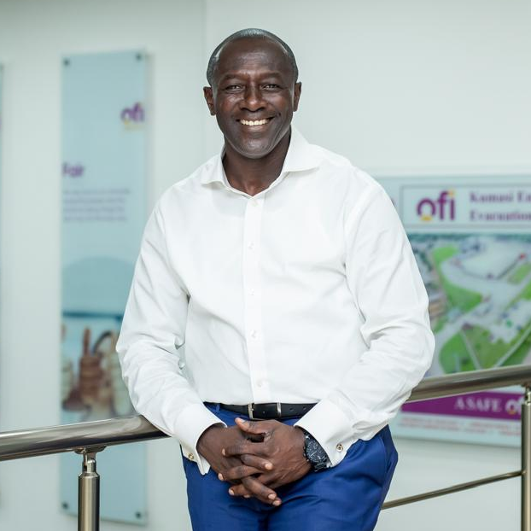
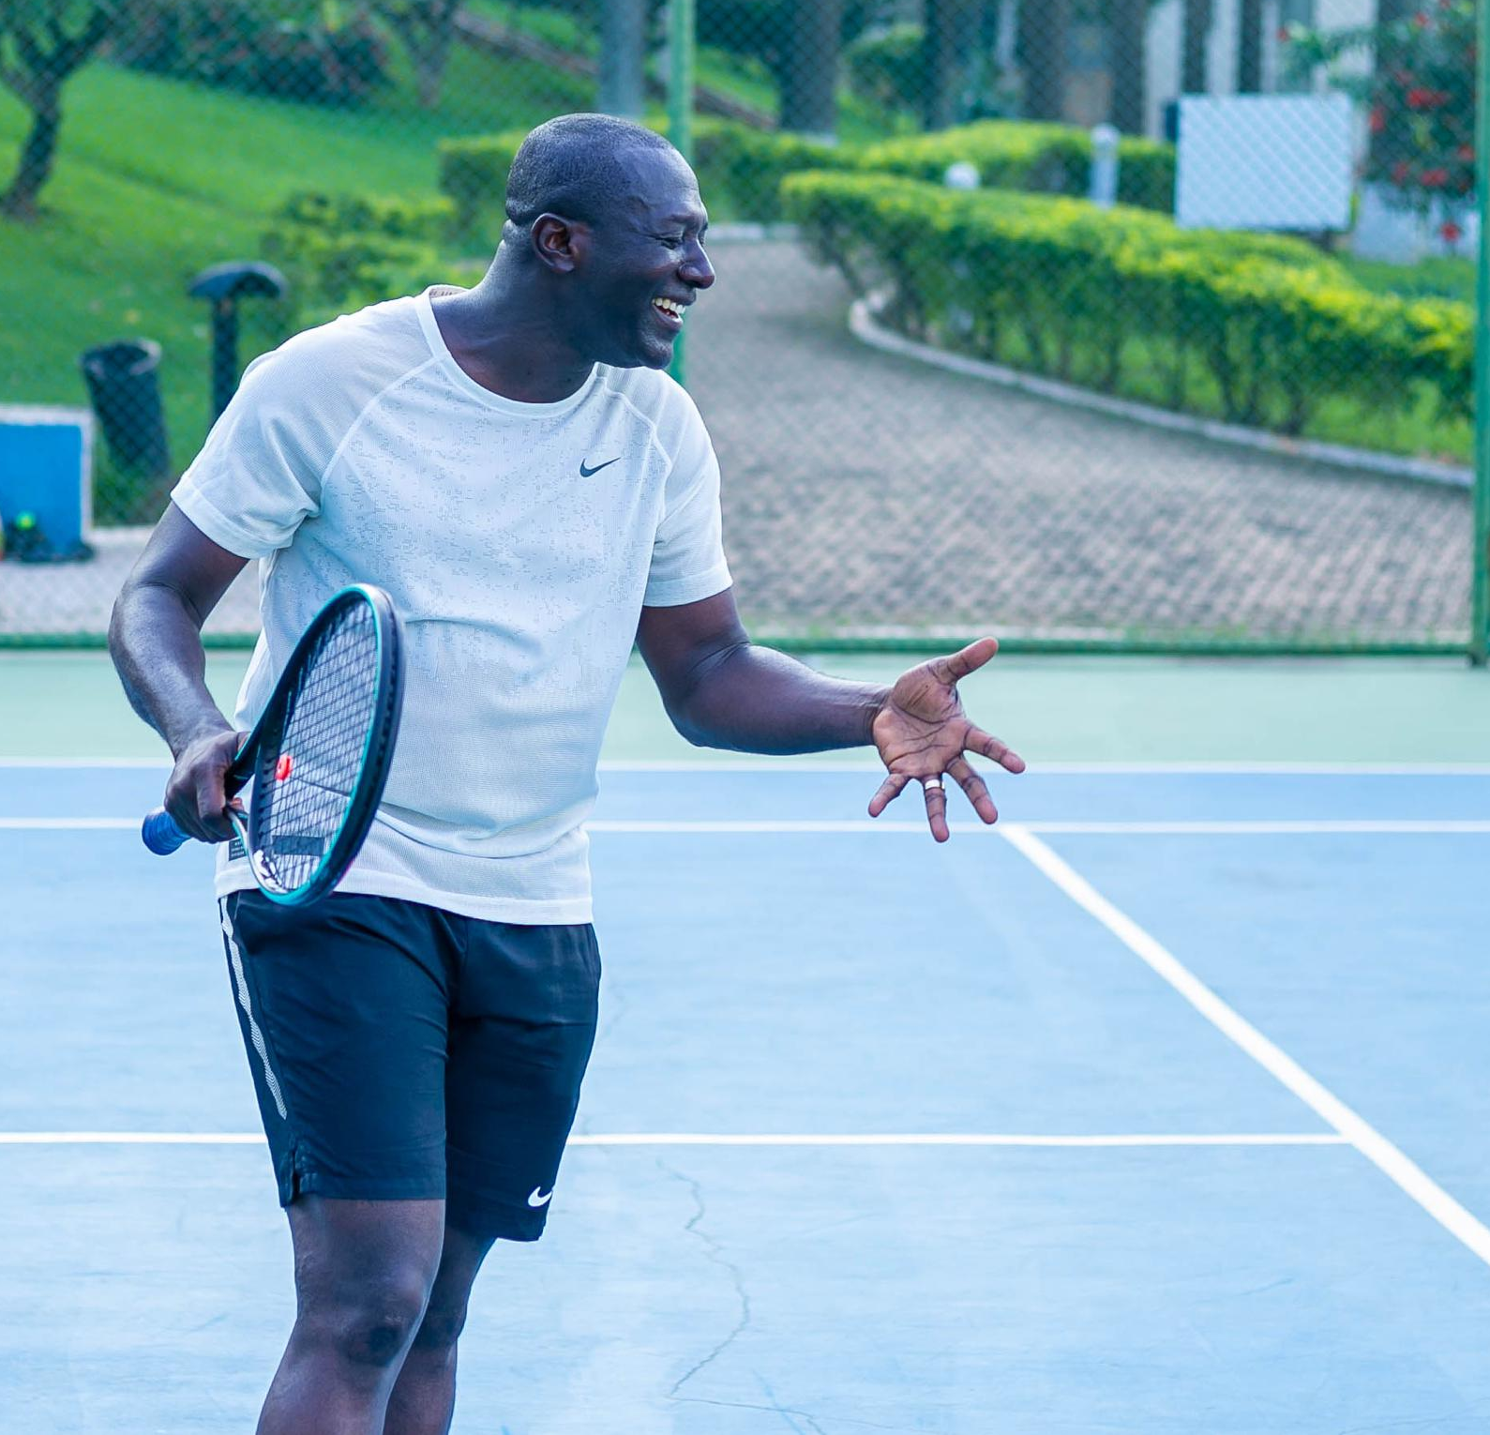
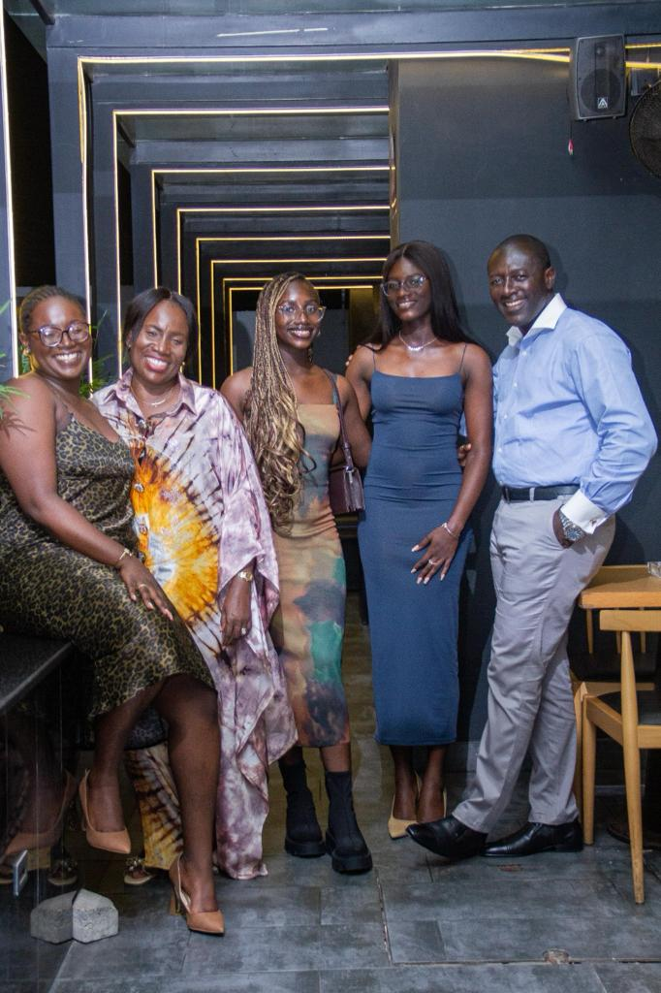
Getting to Know Me
Work
Personal
My role
Country Head, ofi Ghana; Business Head/Cocoa;
Chair/Africa IDE;
Significant others/family members / furry friends in my life
Her Ladyship Justice Afia Serwa Botwe
Tenure in ofi/Olam
25 Years
How I enjoy spending my free time
Playing tennis and spending time with family
Previous companies I have worked at
Cashew & Spices Products Ltd/Ghana
My favorite / comfort food
Beans, & plantain, and Fufu
Why I joined ofi/Olam and what keeps me here?
I joined ofi because its values align with my own, offering opportunities for professional growth, a collaborative culture, and the chance to contribute to innovative projects that make a meaningful impact
My favourite song
Spiritual nourishing Christian song
Eric Botwe
‘Uncle Eric’
A few fun facts about me
Leadership expertise of 31 years in Industry and 22 years in ofi
Loves singing Spiritual, nourishing Christian songs
Capturing moments
This is me outside work, doing stuff I enjoy in my life …

